Slide 1
COMPUTER VISION • TECHNICAL PRESENTATION
Analyzing Perspective Distortion
in Real-World Images
How geometry, lenses, and viewpoint reshape what a camera sees
Course: Computer Vision (ITA05)
Topic: Analyze perspective distortion in real-world images, using visual examples and structured explanation

Slide 2







Agenda
What we'll cover
What Is Perspective Distortion?
Visual Example — Perspective Compression
Projecting a 3D world onto a 2D sensor
Focal length & camera distance
A Taxonomy of Distortion Types
Root Causes
Keystone, barrel, pincushion & compression
What drives each distortion type
Visual Example — Keystone Effect
Correction Techniques
Converging verticals in architecture shots
Calibration & software correction
Visual Example — Lens Distortion
Key Takeaways
Barrel vs. pincushion grids
Practical guidance for real systems
Perspective Distortion in Real-World Images
2

Slide 3
What Is Perspective Distortion?
3D Scene → 2D Image
The Problem Statement
A camera projects a 3D scene onto a flat 2D sensor. That projection is a geometric approximation, not a perfect copy — angles, distances, and straight lines can all appear to change shape once captured.
Perspective distortion refers to any mismatch between real-world geometry and how that geometry appears in the captured image — caused by viewpoint, lens optics, or both.
lens
3D object
image plane
It matters for computer vision because downstream tasks — measurement, 3D reconstruction, object detection — all assume some model of how the scene maps to pixels.
Key idea: the further a ray travels off-axis before hitting the image plane, the more its apparent position departs from an idealized flat projection.
Perspective Distortion in Real-World Images
3

Slide 4
A Taxonomy of Distortion Types
Two families of causes, four recognizable visual signatures
Keystone Effect
Barrel Distortion
Pincushion Distortion
Perspective Compression
Viewpoint-driven
Lens-driven
Lens-driven
Viewpoint-driven
Vertical or horizontal lines converge when the camera is angled relative to a flat plane (e.g., tilted up at a building).
Straight lines bow outward from the center — common with wide-angle and fisheye lenses.
Straight lines bow inward toward the center — common with telephoto and zoom lenses.
Objects at different depths appear closer in size than they are, from a distant, zoomed-in viewpoint.
Perspective Distortion in Real-World Images
4

Slide 5
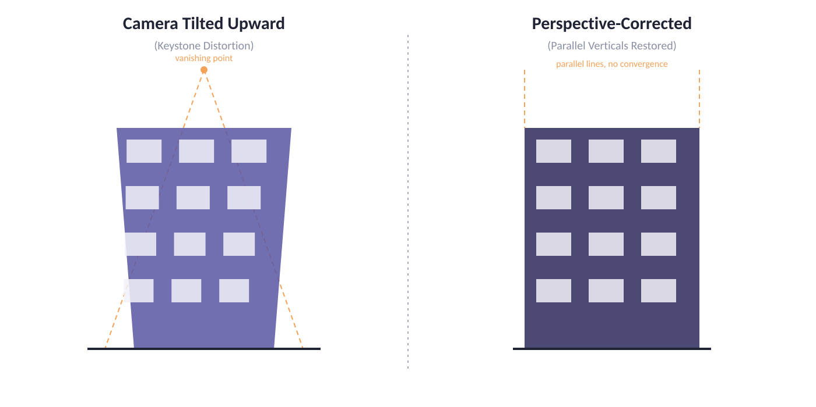
VISUAL EXAMPLE
The Keystone Effect
Why it happens: pointing a camera upward (or downward) tilts the image plane relative to the subject's vertical lines. The top of the building sits farther from the lens along the optical axis than the base, so it projects smaller — the sides appear to converge toward a vanishing point.
Perspective Distortion in Real-World Images
5

Slide 6
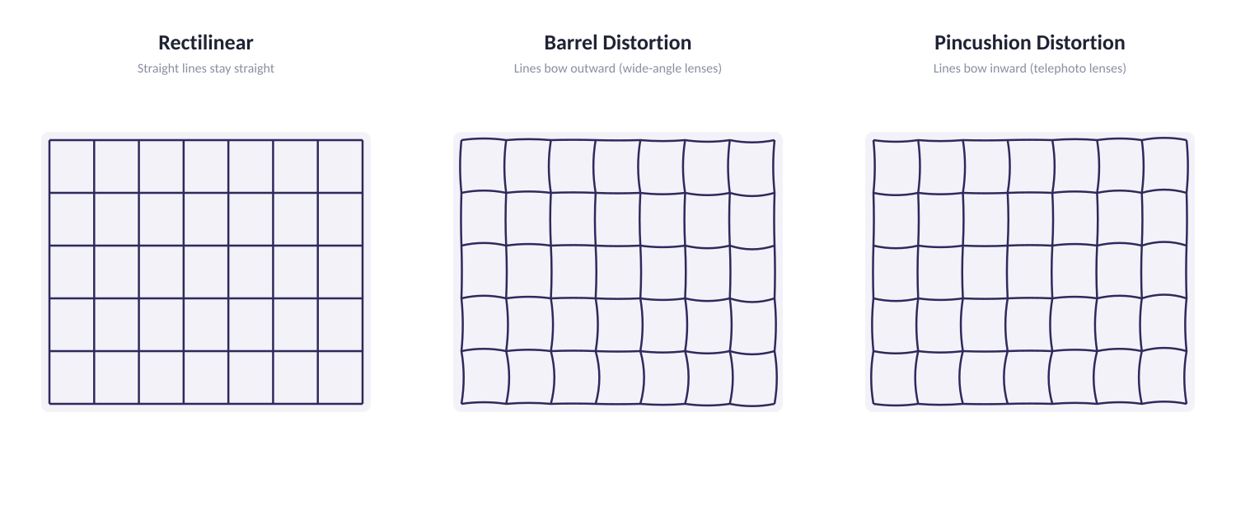
VISUAL EXAMPLE
Lens-Induced Distortion
Why it happens: real lenses refract light unevenly across their surface. Wide-angle lenses tend to magnify the center less than the edges (barrel); telephoto/zoom lenses often do the reverse (pincushion). Camera calibration models this with radial distortion coefficients.
Perspective Distortion in Real-World Images
6

Slide 7
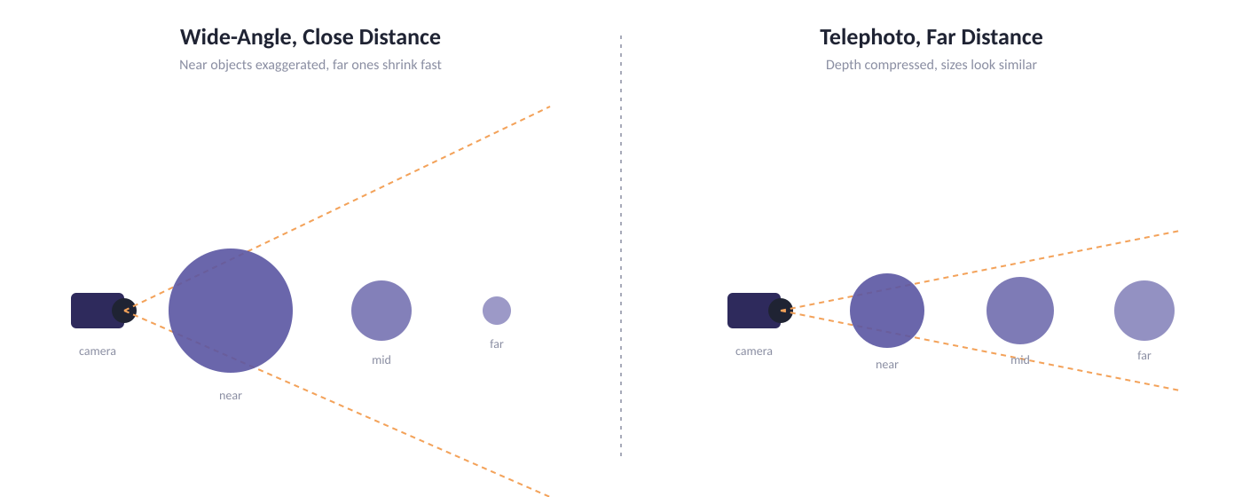
VISUAL EXAMPLE
Perspective Compression
Why it happens: apparent size falls off with distance from the camera. Standing close with a wide lens exaggerates that falloff (near objects loom large); standing far away with a telephoto lens flattens it (near and far objects look similarly sized).
Perspective Distortion in Real-World Images
7

Slide 8

Root Causes, Structured
Every distortion traces back to one of four variables
Camera Angle
Focal Length
A non-perpendicular viewpoint relative to a flat subject creates converging lines (keystone effect).
Wide focal lengths exaggerate depth differences; long focal lengths compress them.
Lens Geometry
Sensor & Distance
Imperfect optical elements bend light unevenly across the field of view, producing barrel or pincushion curvature.
Subject distance relative to sensor size changes how strongly perspective effects present in the frame.
Perspective Distortion in Real-World Images
8

Slide 9
Correction Techniques
Matching each distortion family to its structured fix
Geometric (Keystone) Correction
Lens Calibration
Shoot-Time Discipline
Model-Aware Pipelines
Apply a projective transform (homography) to re-map converging lines back to parallel — standard in architectural and document scanning software.
Estimate radial & tangential distortion coefficients (e.g., via a checkerboard calibration pattern) and undistort every frame before use.
Increase camera distance and shooting angle awareness so the desired perspective is captured correctly, reducing reliance on post-processing.
Downstream CV models can be trained or calibrated to be robust to residual distortion, or to explicitly use camera intrinsics.
Principle: correct at capture where possible; calibrate mathematically where you can't.
Perspective Distortion in Real-World Images
9

Slide 10
Why This Matters Beyond Photography
Perspective-aware correction is foundational to many CV systems
Architecture & Real Estate
Autonomous Vehicles
AR / VR & 3D Reconstruction
Corrected verticals are essential for professional, measurement-accurate property and building photography.
Camera calibration removes lens distortion before perception models estimate distances and lane geometry.
Accurate undistortion is a prerequisite for mapping 2D pixels back to consistent 3D coordinates.
Outlook: as vision systems increasingly stitch, measure, and reconstruct from images, treating perspective distortion as a first-class, correctable signal — not a cosmetic flaw — is central to reliable results.
Perspective Distortion in Real-World Images
10

Slide 11

Key Takeaways
Perspective distortion comes from two independent sources: viewpoint geometry (keystone, compression) and lens optics (barrel, pincushion).
Each type has a distinct, recognizable visual signature — converging lines, bowed grids, or squeezed depth.
Root causes trace to camera angle, focal length, lens geometry, and subject distance — all measurable and controllable.
Correction is layered: shoot-time discipline, geometric transforms, and lens calibration each address a different part of the problem.
Thank you
Perspective Distortion in Real-World Images
11

